Slide 1
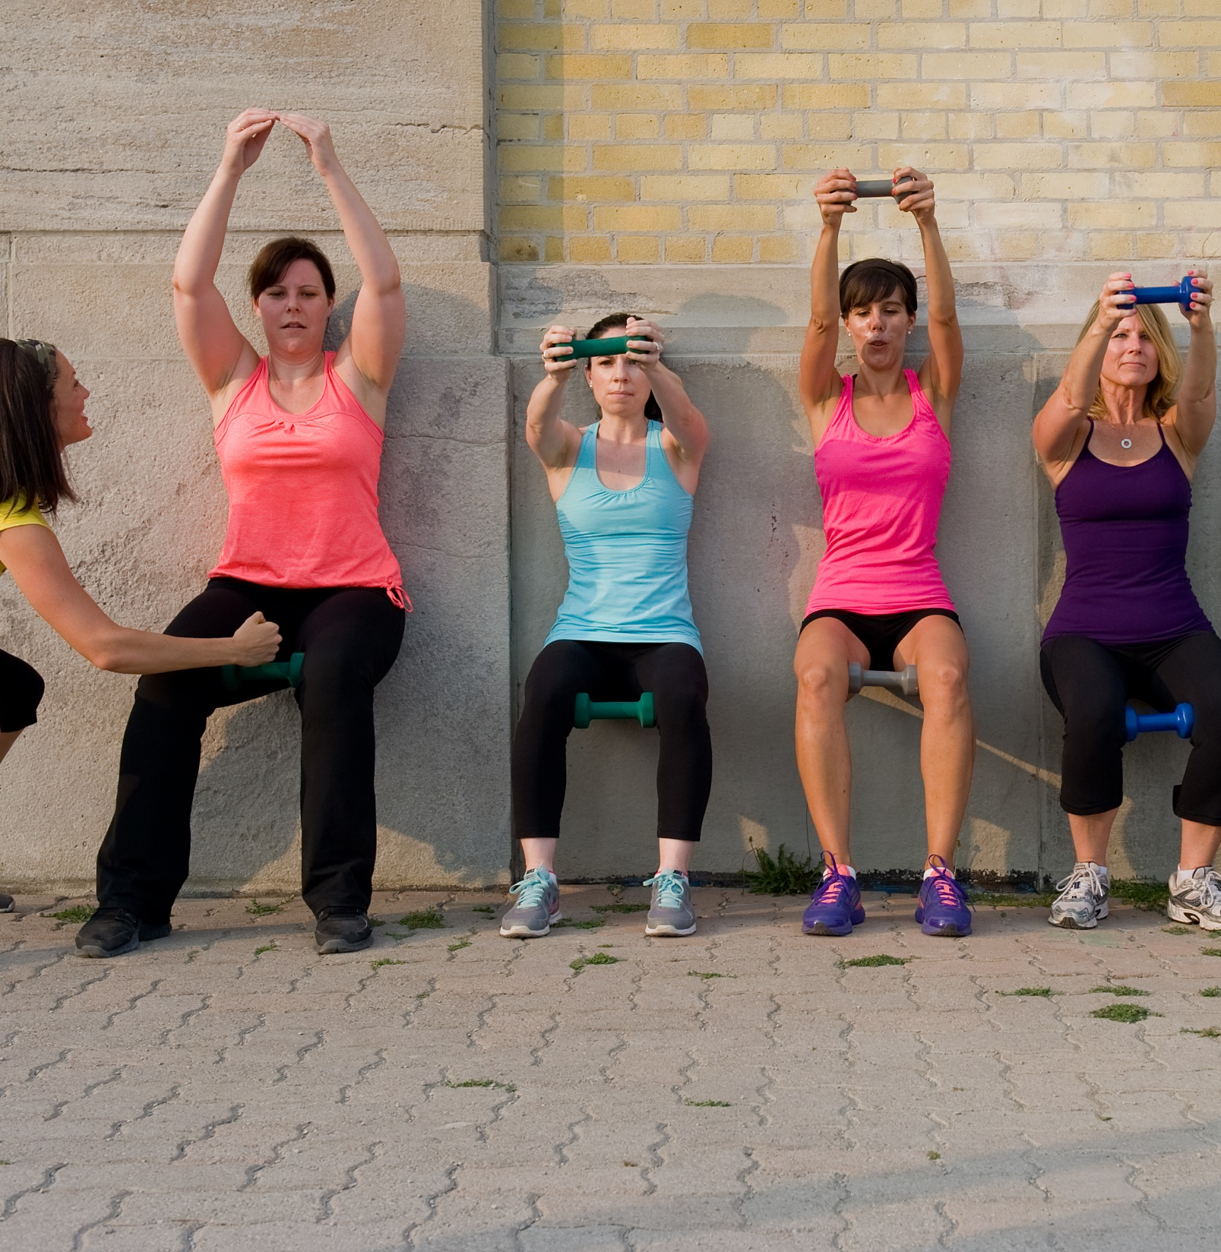

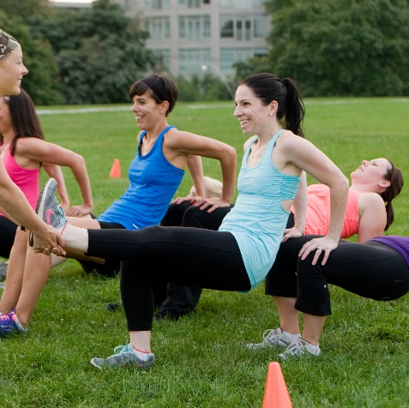
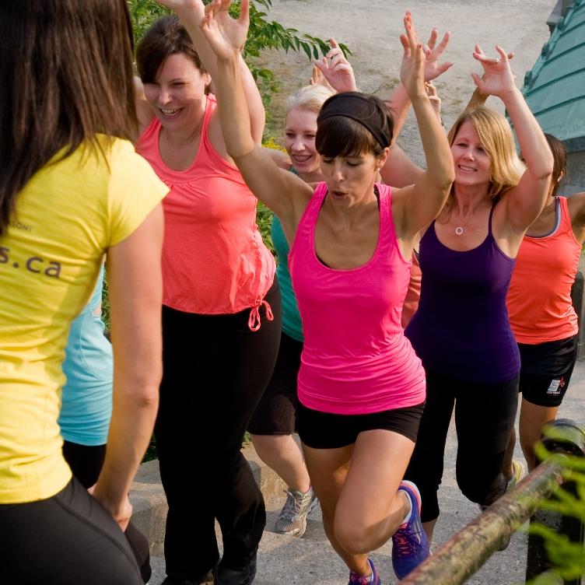
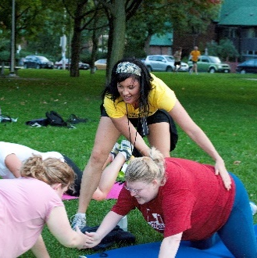
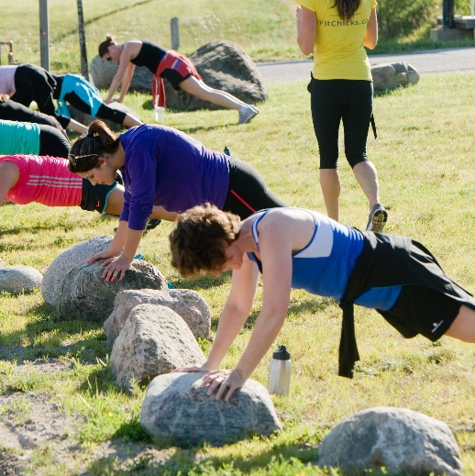
FITNESS & NUTRITION EXPERT PROGRAM
Orientation
Class of April 2020

Slide 2

Before we get ready to rock, just a few things:
In case of tech probs, this is what to do:
  If you get kicked out or power out, just log back in
  If we get kicked out or power out, please to log back in to the same link to asap to continue on .
Access to this recording:
  This Orientation is taped
  To view after, it will be posted on the homepage of FIT CHICKS Members Only site
We heart questions!
  Please type all questions in the chat box. If you want your question to be anonymous, please just send to “HOST”

Slide 3
ORIENTATION DAY: What we are going to cover
WELCOME THE CLASS OF 2020
OBJECTIVES OF PROGRAM
What YOU will learn and what we want you to take away
INTRO TO FIT CHICKS & YOUR INSTRUCTORS:
  Who we are, bios, our mission & overview of learning
OVERVIEW OF PROGRAM:
How long each section will be, what is included in each section, marking breakdown, etc
HOW TO ACCESS FILES:
How to submit assignments, where to download forms, where to access recordings, etc

Slide 4

ORIENTATION DAY: What we are going to cover
PRACTICAL HOURS
  When your practical hours start,& what it includes
ACCREDITATION WITH CAN FIT PRO & CONTINUING ED WITH NASM
  What that means and how to apply
RECERTIFICATION
  Your certification and how to keep it current
ACADEMY RULES:
  What are our expectations, due dates, respecting deadlines

Slide 5
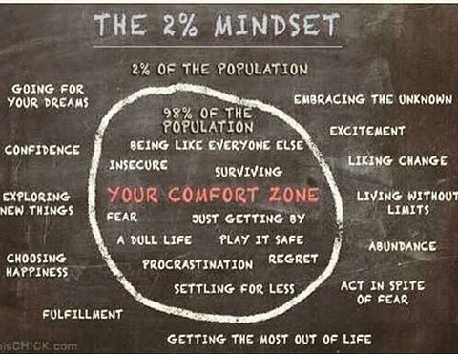
Notes:
Congratulations chick – you are about to head on an amazing journey!
Yes we are going to learn a ton about fitness, nutrition, wellness and business in this program but you are also going to learn about yourself. There will be a lot of self discovery in this course. There will be a lot of critical thinking. At time it may feel hard or overwhelming or challenging. We are going to not only learn how
Change and learning can be overwhelming, we want you to embrace it and know it is OK. This is part of growth. This is part of uncovering your fierceness and embracing your talents
This course is moving fast and we want you to know that this is a journey. We all learn at different rates, paces, ways, etc and we have worked hard to try to encompass all of these. One of my mentors always says “Everything is figuroutable” so if at any point you feel like something is too much or there is a concept, just take a breath and remember we are a family. We are all here with the goal to build healthier and happier lives and communities, and we will get there.

Slide 6

WRITE IT DOWN
Why did you sign up for this course?
What do you want to accomplish during the next 3 months?
What kind of life do you want?
“

Slide 7
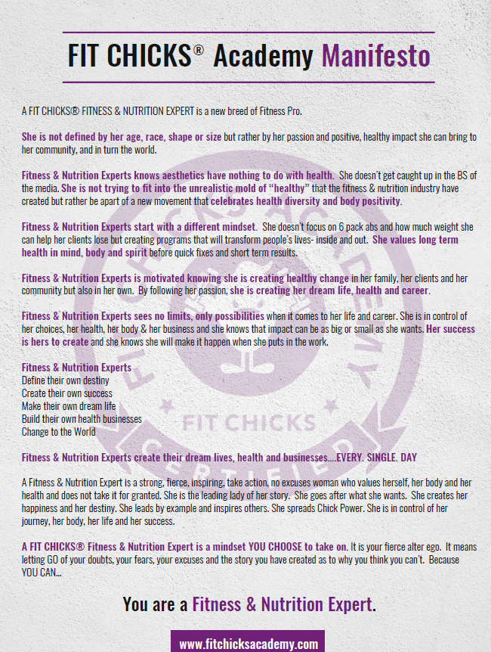
Notes:
This is a journey
We

Slide 8


Slide 9
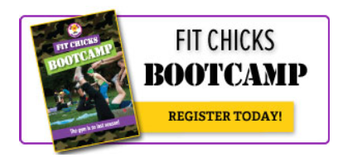
Once upon a time, 2 chicks from Ottawa started with a dream to get other chicks fit, fierce & inspired.
In 2008, they launched FIT CHICKS Bootcamp in Toronto & 7 chicks showed up…..

Slide 10
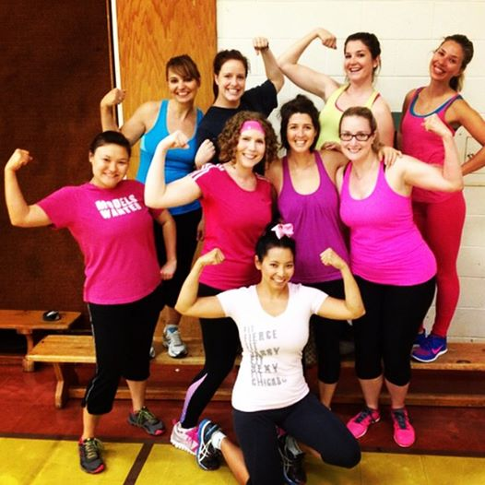
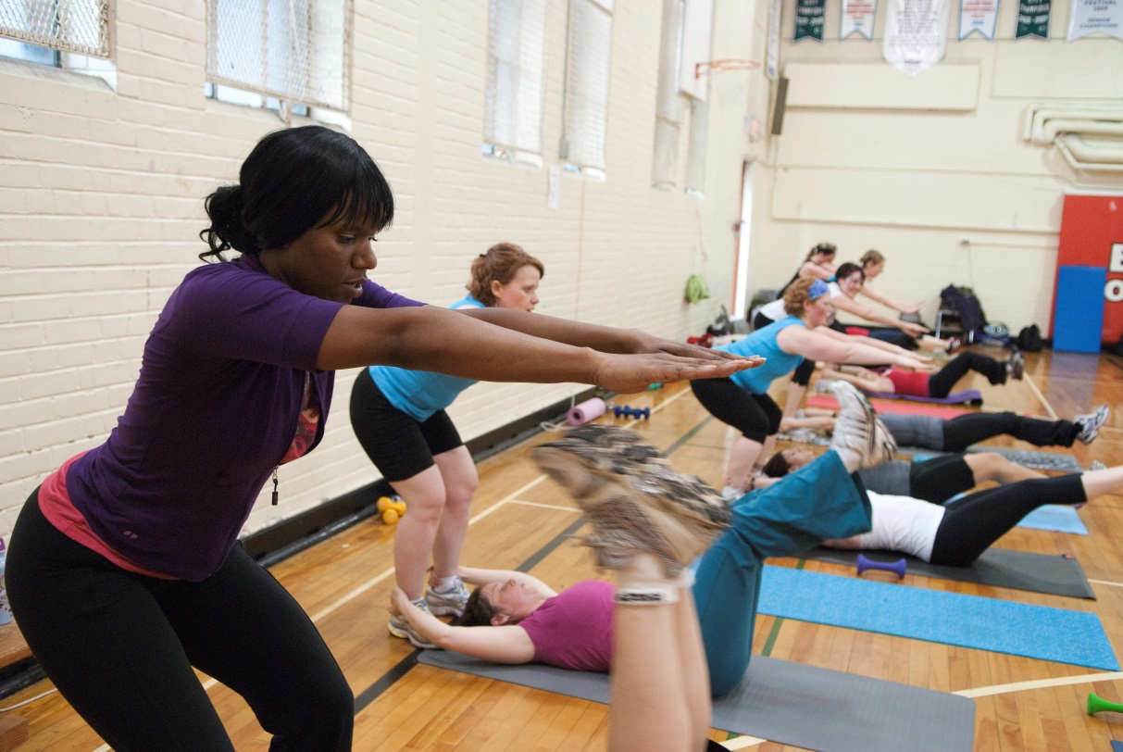
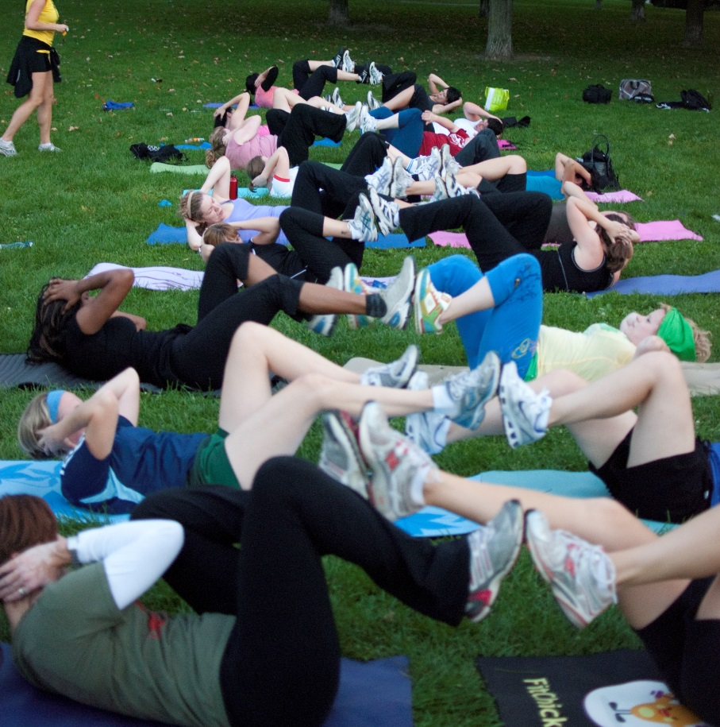
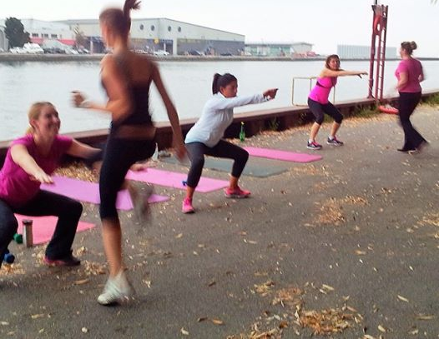

Slide 11
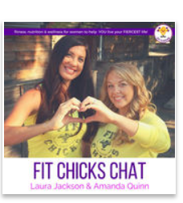





Slide 12

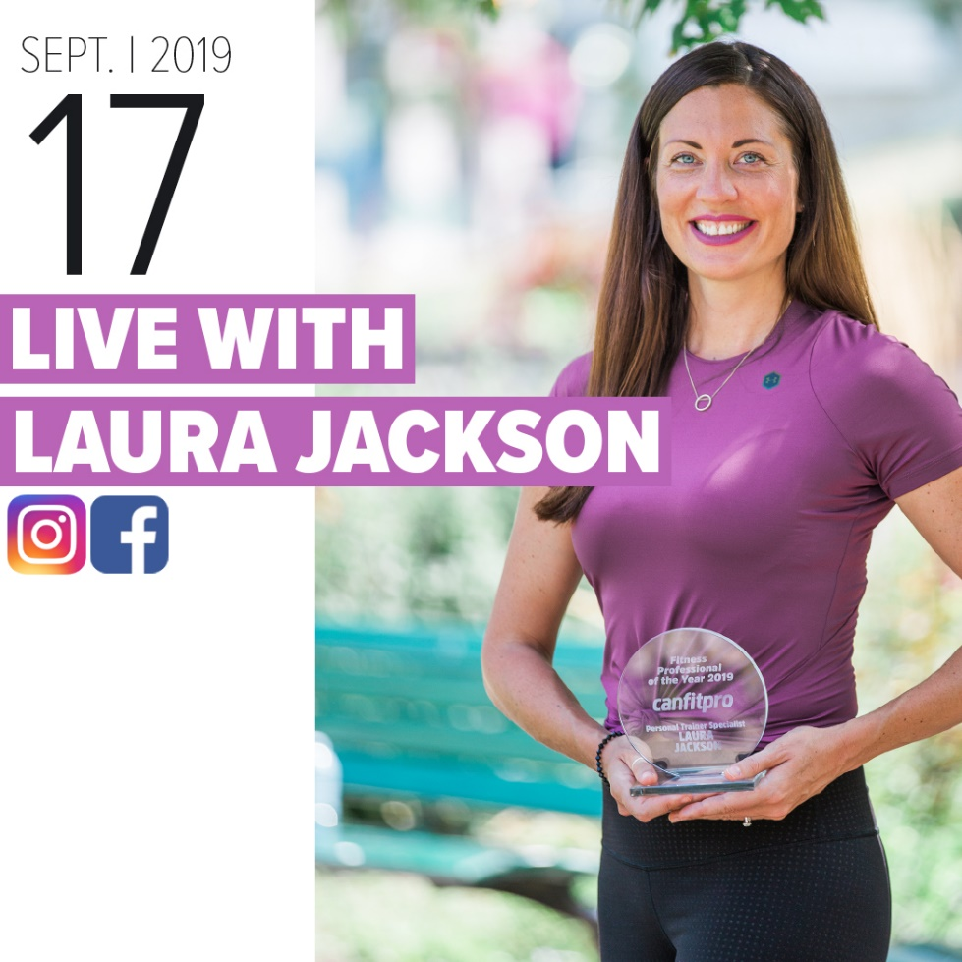


Slide 13

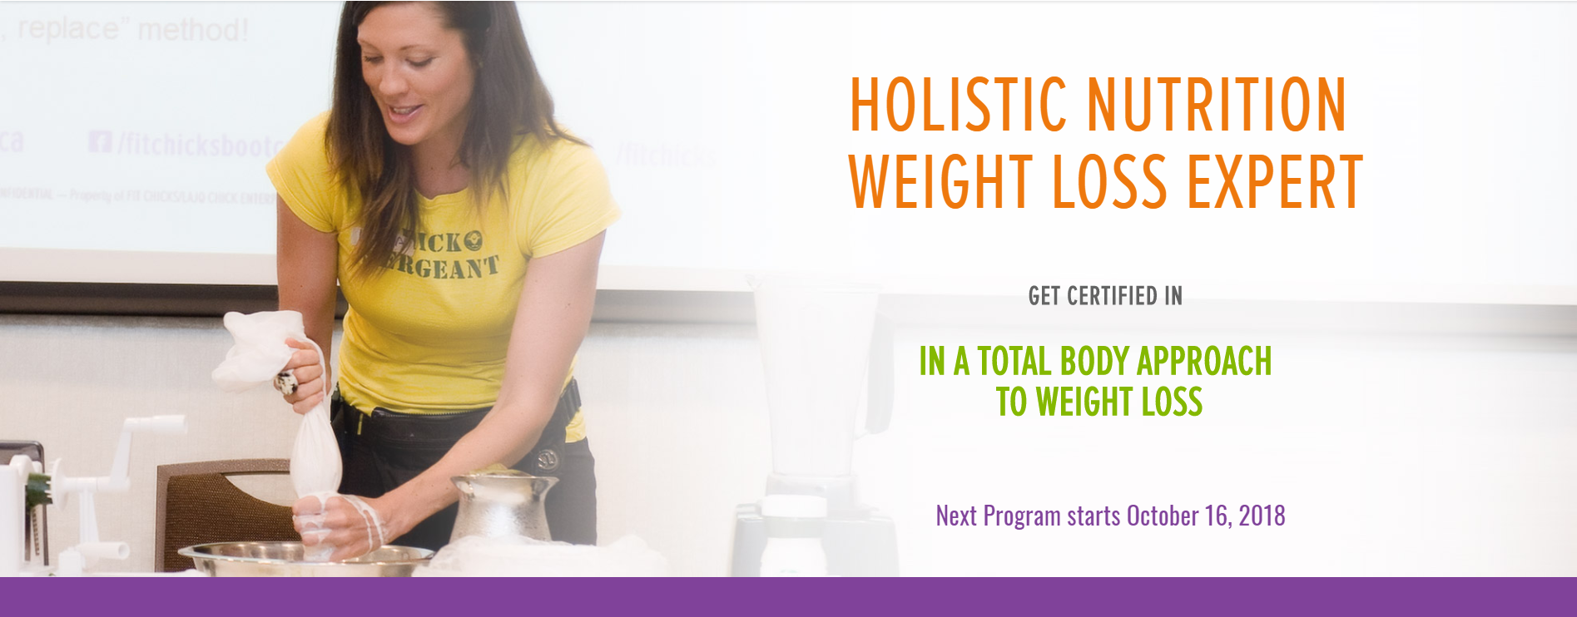


Slide 14

MEET YOUR FIERCE INSTRUCTORS!

Slide 15
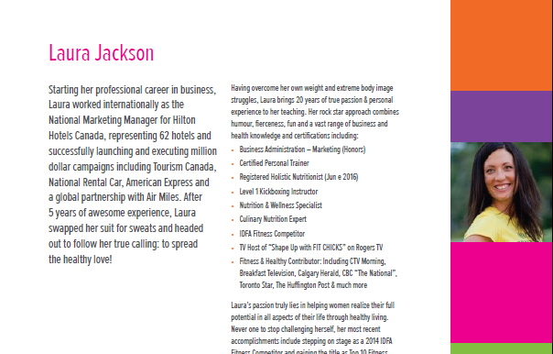

Slide 16
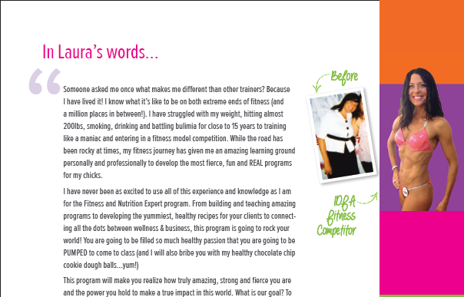

Slide 17
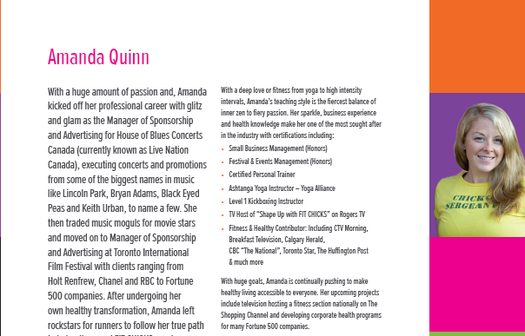

Slide 18
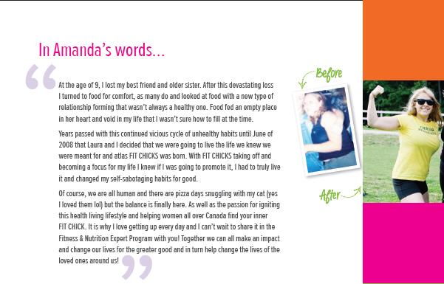

Slide 19
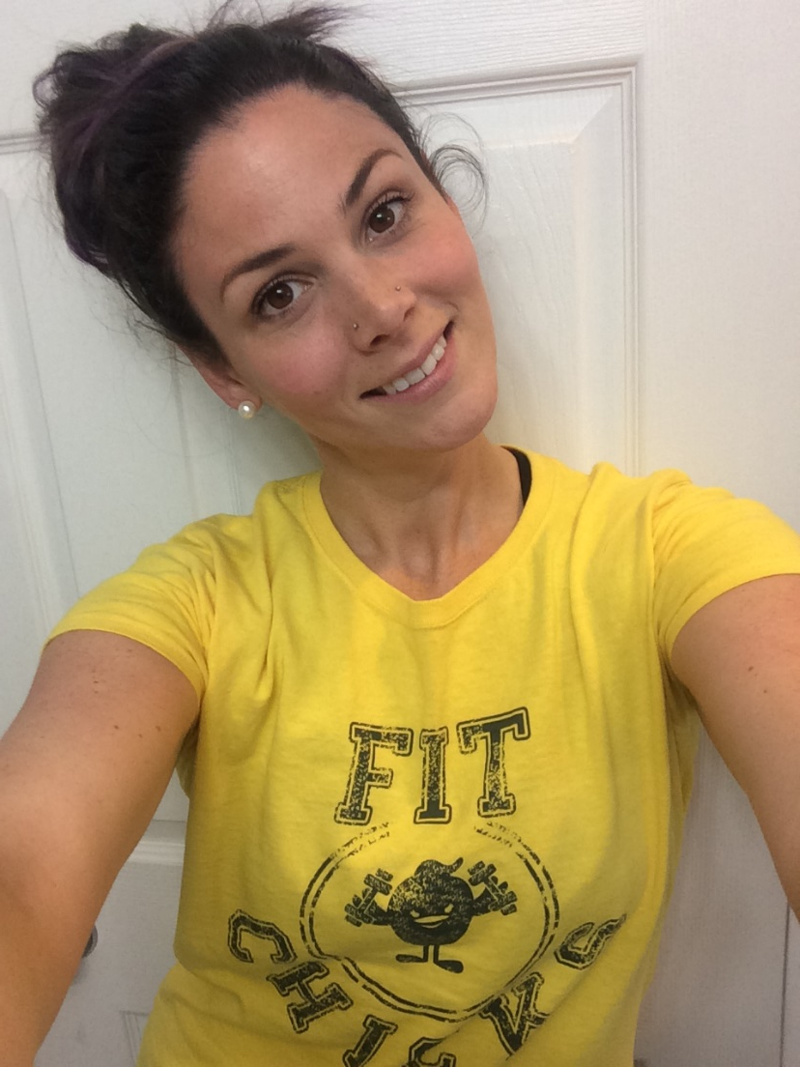
JESSICA ESTRELA
BSc in Human Kinetics from the University of Ottawa,
Certified Exercise Physiologist
Registered Massage Therapist
Spinning instructor
Certified Personal Trainer and group fitness instructor
Marathon Runner & Ironman Athlete
Educator in the human body, movement, injuries and more
FIT CHICKS® Academy - Anatomy
FIT CHICKS® Academy - Programs Manager
Notes:
Oonagh is a fitness industry veteran and was recently named Pro Trainer of the Year by the Canadian Association of Fitness Professionals. She is a regular Fitness Expert on the Steven and Chris show as well as an acclaimed speaker in the corporate sector and educator for new fitness professionals. She is the founder and head trainer of Fit Feels Good and Fit Feels Good Education She teaches the canfitproPersonal Training certification course as well as CPR and loves to mentor new fitness professionals. She holds additional certifications in Yoga, TRX and Kettlebells, Zumba, Pre and Postnatal fitness and Les Mills’ RPM and BodyPump. She is a Master Trainer for the GROOVE Method and co-authored the manual for the Pre and Post Natal GROOVE Certification. Oonagh has been profiled in Glow and Toronto Life magazines for her exceptional training. She also has an MA in Acting from the East 15 Acting School in London and is a published and internationally-produced playwright. When she’s not training, she’s hanging out with her three year old, Felix and her one year old, Otis.

Slide 20


Slide 21
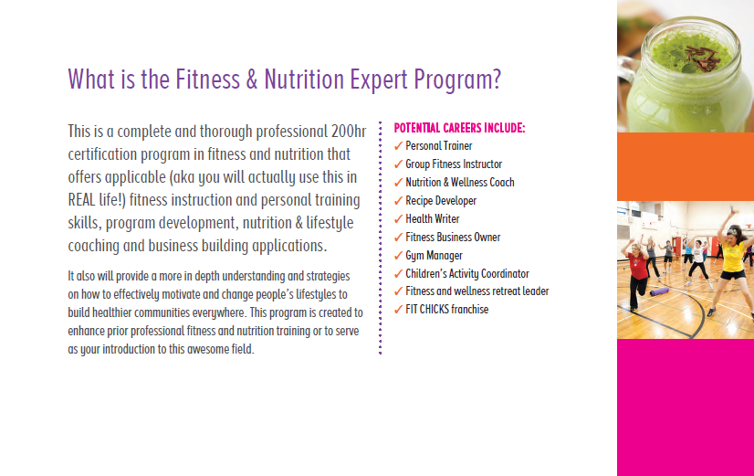

Slide 22
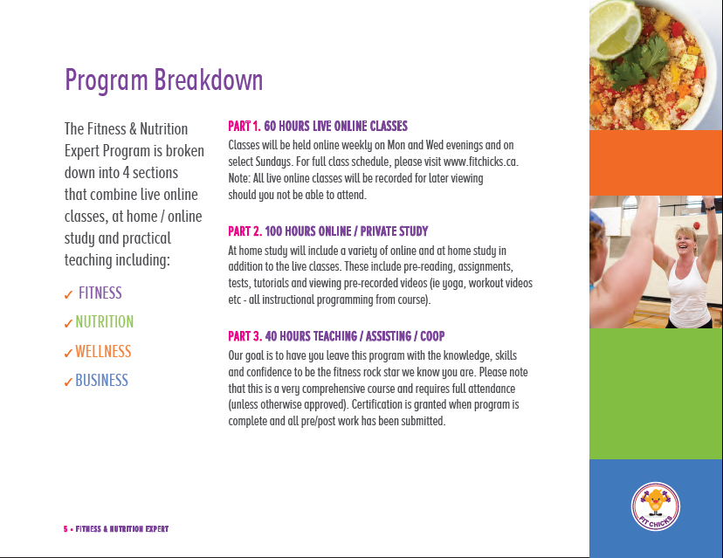

Slide 23
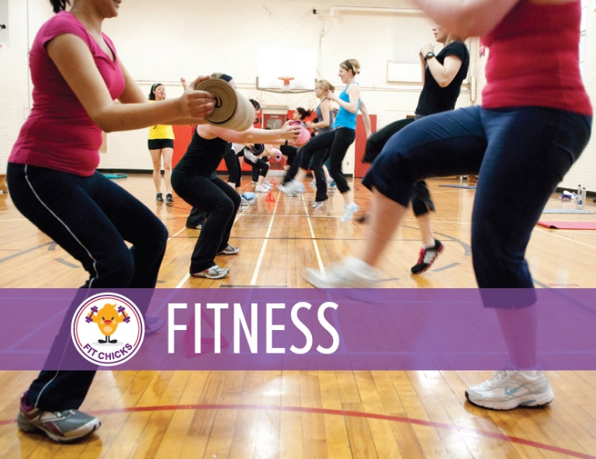


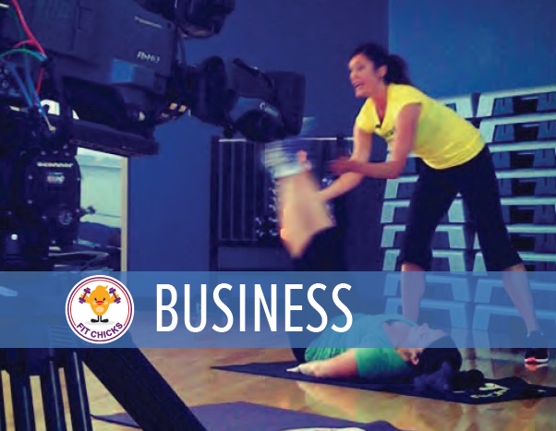
4 SECTIONS

Slide 24

Class dates: April 3 – May 20th
Marking Breakdown:
2 assignments
5 mini Quizzes
Written exam
Practical exam
Required Books:
Strength Training Anatomy – Frederic Delavier
ACSM's Complete Guide to Fitness & Health 2nd Edition

Slide 25
Class dates: May 28 – June 12th
Marking Breakdown:
2 assignments
1 Quiz
Written exam
Required Books:
“Fierce in 8” Recipe Book by FIT CHICKS
“Practical Paleo” by Dianne Sanfilippino
Also see recommended readings

Slide 26
Class dates: June 18- 25th
Marking Breakdown:
1 assignments
Written exam
See recommended readings

Slide 27
Release Date – June 26th
Optional – Build Your Fitness & Nutrition Biz Plan

Slide 28
DEADLINE:
Oct 1st, 2020
To graduate, all assignments, practical hours and CPR must be completed within 3 months of final wrap up

Slide 29

Fitness & Nutrition section include short quizzes (max 10 questions) following select classes. Amount of quizzes will vary by section.
For quiz dates, please see the “Calendar and Modules Overview”.
You can access the quiz in the FNE Members website under each module tab following the online classes.
Quizzes are automatically marked online and you will receive your mark immediately upon completion.
Please note these are open book and only related to the content being taught
QUIZZES
Notes:
See “FIT CHICKS Fitness & Nutrition Expert 2016 – Guidelines & Calender” for full details

Slide 30
Each section will include a min of 1 assignment. Amount of assignments will vary by section.
Assignments will be explained in a video labelled accordingly – example “Fitness Assignment 1 Video”.
For assignment issue dates and deadlines, please see the “Calendar and Modules Overview”.
You can access the assignments in the FNE Members website under each module tab following the issue date. It is a word document so you can type your answers directly in.
To submit your assignment, complete the assignment and upload under the FNE Members Tabs with the subject line “ Fitness Assignment 1 - YOUR NAME".
Written assignments will be marked and returned with feedback within 14 business days of receipt. In the event an assignment is not completed to standard, we will return with feedback to rework and resubmit to ensure the concepts are understood.
ASSIGNMENTS
Notes:
FOR ASSIGNMENT POLICY, please see “FIT CHICKS Fitness & Nutrition Expert 2016 – Guidelines & Calender”

Slide 31
Each section will include a final written exam. The fitness section will include a written and practical exam
Written exams may consist of multiple choice.
For exam dates, please see the “Calendar and Modules Overview”.
You can access the exam in the FNE Member website under each module tab following the online classes.
Please note the written exam is open book and only related to the content being taught
Practical exam will be submitted via video submission from the student utilizing Youtube.
IMPORTANT!!! The practical exam CANNOT be submitted until Fitness Assignment 1 & 2 and practical marked and returned to you to ensure you understand the content and practical hours are complete. They must be submitted by Sept 10^{th.}
EXAMS

Slide 32
How do you access all of the Fitness & Nutrition Expert “Goodness” and what is upcoming?
Let’s take a peek at the FNE Members Site!
https://www.fitchicksacademy.com/members-log-in/

Slide 33
PRACTICAL HOURS OVERVIEW

Slide 34
PRACTICAL HOURS OVERVIEW
PART 1: OBSERVATION / PARTICIPATING IN FITNESS CLASSES
This portion of the co-op / practical can begin after program start
Observation / Participating in 2 group fitness classes of choice OR fitness videos
Examples of group fitness would be bootcamp, Zumba, Pound, yoga, Cross fit, etc
Examples of Videos would be 80 Day Obsession (Beachbody Videos)

Slide 35
PRACTICAL HOURS OVERVIEW
PART 2 – TEACHING / PERSONAL TRAINING PRACTICE HOURS
Teach 4 – 60 min Group Fitness Classes and 3 – 60 min sessions Personal Training
For group co-op / practice classes, students must complete the 4 FIT CHICKS workouts under the Co-op tab.
For the PT co-op workouts, students must complete the 3 FIT CHICKS Personal Training Workouts under the Any questions regarding the workouts, please contact Amanda@fitchicks.ca
Practice group classes must have a min of 2 participants. PT session need 1 participants. Participants can be male or female.
This portion of the co –op can begin after Fitness Session 8

Slide 36
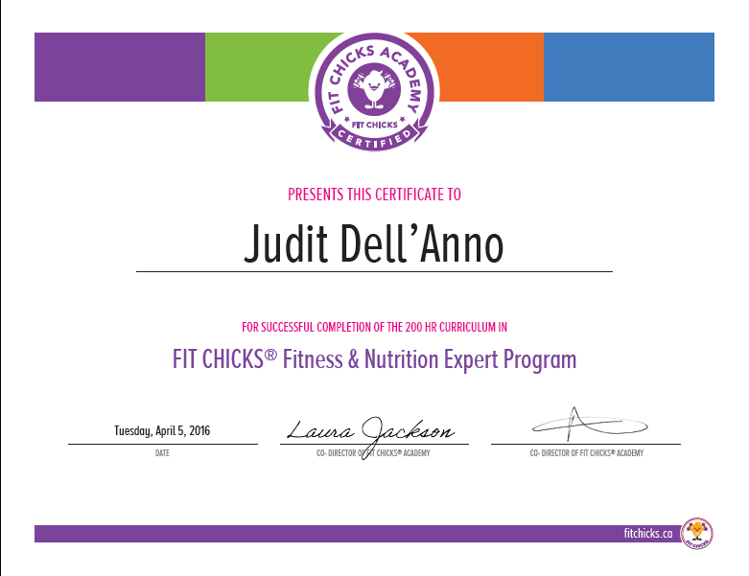
CERTIFICATION
Once you have successfully completed the program, you will receive:
Title of Certified Fitness & Nutrition Expert (FNE) by FIT CHICKS Academy
Certificate of Completion
The Fitness & Nutrition Expert certification seal and digital materials to show the world your awesome skills
Ability to receive insurance as a Fitness & Nutrition Expert with Hub International (Canada) or K&K Insurance (USA) – must have CPR A, C or HCAP
Ability to join the Fit Pro Travel Network to do teaching vacation at participating all inclusive hotels around the world

Slide 37

ACCREDITED WITH CAN FIT PRO
FNE is equivalent to receive your Fitness Instructor Specialist and / or Personal Training Specialist with Can Fit Pro
Once you receive FNE certificate, you can submit the Certification Accreditation Form with Can Fit Pro equivalency (fee applies)

Slide 38
RECERTIFICATION
In order to maintain your FNE cert in good standing, you are required to:
Complete 8 hours of continuing ed (equivalent to 4 CEC’s) per certification year to keep your FNE cert in good standing
Done online through FIT CHICKS University with 4 tutorials in Fitness, Nutrition, Wellness and Business
Can be done anytime in the certification year. If submitted after the re cert date, you may not be eligible for recert. Fee is $89 / year
CPR must be completed yearly to remain certified (please visit www.canfitpro.com for a list of upcoming CPR in your area. Additional fee)

Slide 39
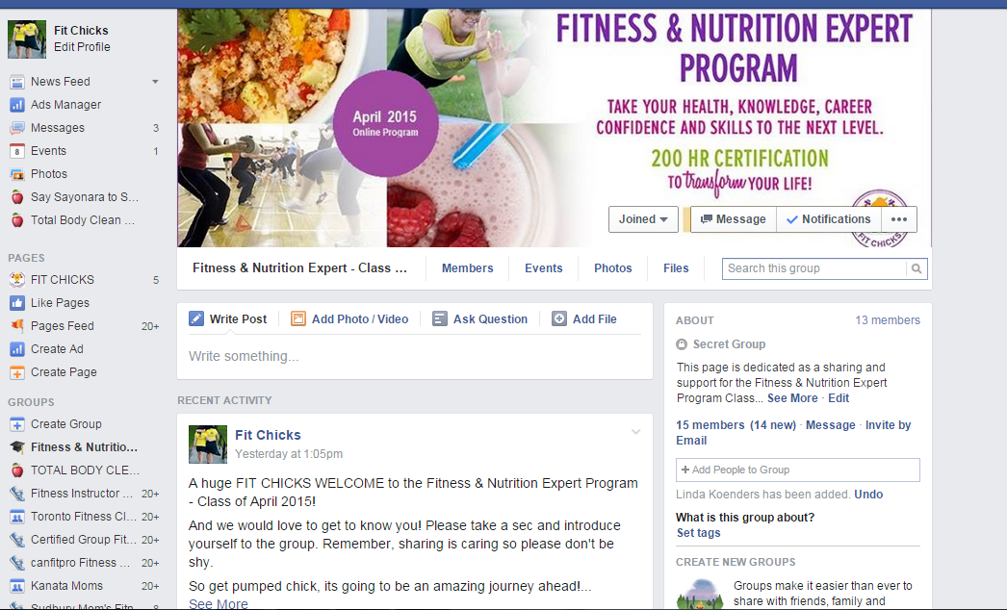
JOIN THE FNE COMMUNITY!
Join the closed Facebook group
Like our Facebook Page
  /fitchicksacademyprograms
Follow us on Instagram
  @fitchicksacademy
Check out the FIT CHICKS Chat Podcast on Itunes, Google Play & Stitcher!

Slide 40


Slide 41
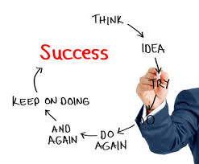
Please remember….
“Show up “ to every class
No distractions – be present
Set a positive learning space – mentally & physically
Respect deadlines
We are moving fast so please stay on top!
Set yourself up for success
Set up your Google Calendar alerts with upcoming classes , due dates etc)
Get an accountability partner in the class to keep on track (ask for one in the FB Group!)
Find your co – op participants NOW
Do required pre or post readings
Be proactive & resourceful
Research the answers before reaching out
Be kind and supportive
To yourself and each other
Share, help each other, FB & Instagram
Notes:
This is a journey
We

Slide 42
FOR ALL PROGRAM QUESTIONS & TECH QUESTIONS, please email:
fne@fitchicks.ca
Let’s have an amazing journey ahead!

